Slide 1
Data Science Unit-V From: Tom M. Mitchell, Machine Learning, India Edition 2013, McGraw Hill Education.
ARTIFICIAL NEURAL NETWORKS

Slide 2
CONTENT
Introduction
Neural Network Representation
Appropriate Problems for Neural Network Learning
Perceptrons
Multilayer Networks and BACKPROPAGATION Algorithms
Remarks on the BACKPROPAGATION Algorithms
Advanced Topics in Artificial Neural Networks.
Case Study: Defeating a CAPTCHA

Slide 3
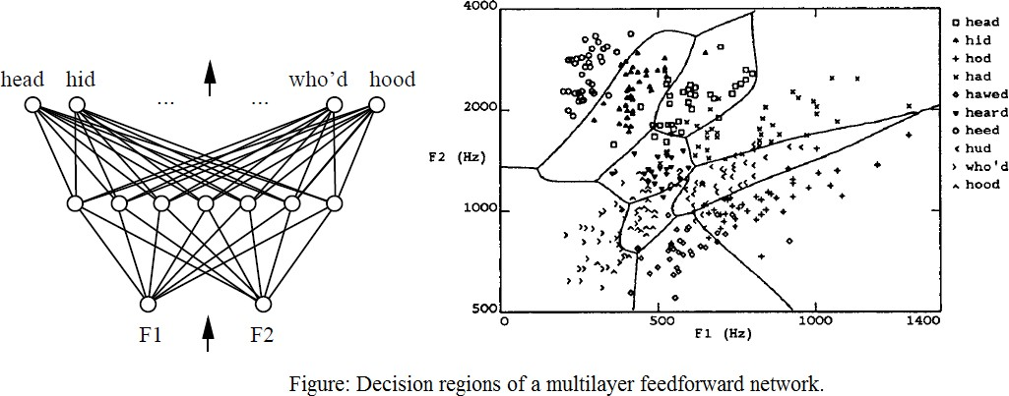
Multilayer Networks and the Backpropagation Algorithms
Multilayer networks learned by the BACKPROPACATION algorithm are capable
of expressing a rich variety of nonlinear decision surfaces
Decision regions of a multilayer feedforward network. The network shown here was trained to recognize 1 of 10 vowel sounds occurring in the context "h_d" (e.g., "had," "hid"). The network input consists of two parameters, F1 and F2, obtained from a spectral analysis of the sound. The 10 network outputs correspond to the 10 possible vowel sounds. The network prediction is the output whose value is highest.
The plot on the right illustrates the highly nonlinear decision surface represented by the learned network. Points shown on the plot are test examples distinct from the examples used to train the network.

Slide 4
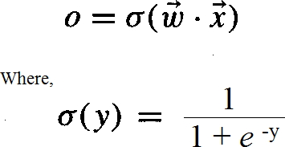
A Differentiable Threshold Unit
Sigmoid unit-a unit very much like a perceptron, but based on a smoothed, differentiable threshold function.
The sigmoid unit first computes a linear combination of its inputs, then applies a threshold to the result. In the case of the sigmoid unit, however, the threshold output is a continuous function of its input.
More precisely, the sigmoid unit computes its output O as
σ is the sigmoid function

Slide 5
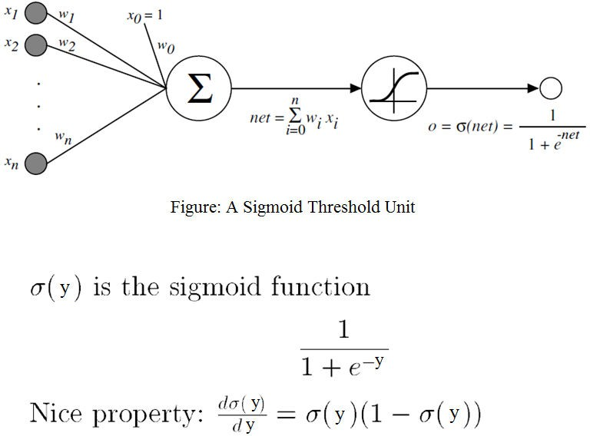

Slide 6
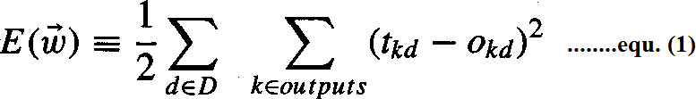
The BACKPROPAGATION Algorithm
The BACKPROPAGATION Algorithm learns the weights for a multilayer network, given a network with a fixed set of units and interconnections. It employs gradient descent to attempt to minimize the squared error between the network output values and the target values for these outputs.
In BACKPROPAGATION algorithm, we consider networks with multiple output units rather than single units as before, so we redefine E to sum the errors over all of the network output units.
where,
outputs - is the set of output units in the network
t_{kd} and O_{kd} - the target and output values associated with the k^{th} output unit
d - training example

Slide 7
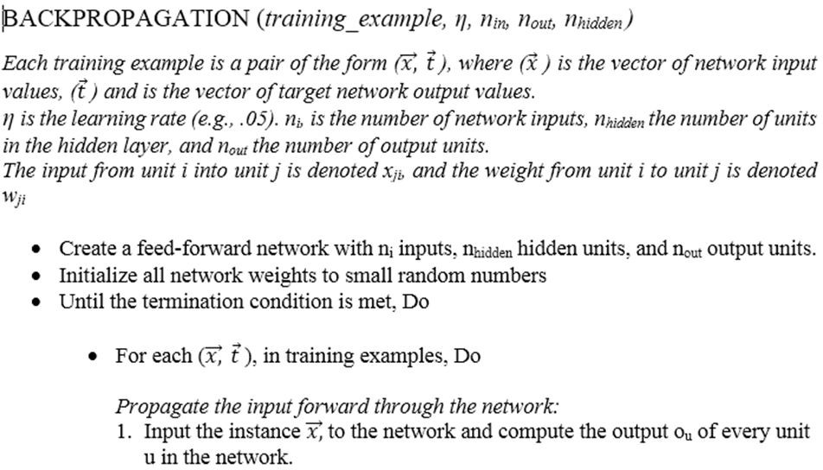

Slide 8
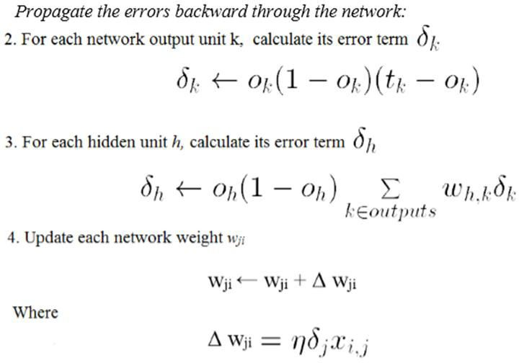

Slide 9
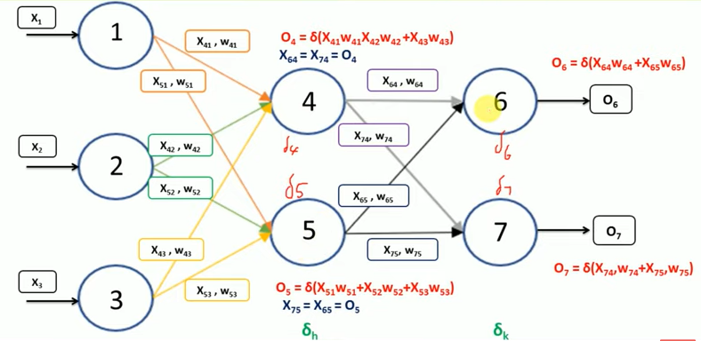

Slide 10
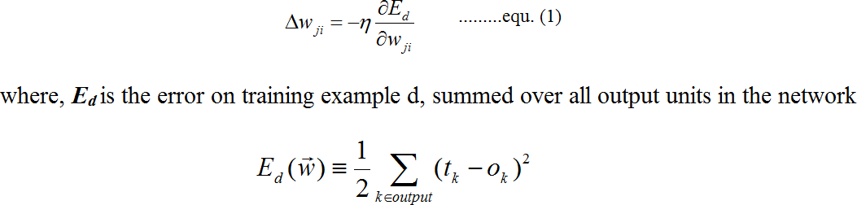
Derivation of the BACKPROPAGATION Rule
Deriving the stochastic gradient descent rule: Stochastic gradient descent involves iterating through the training examples one at a time, for each training example d descending the gradient of the error E_{d} with respect to this single example
For each training example d every weight w_{ji} is updated by adding to it Δ w_{ji}
Here outputs is the set of output units in the network, t_{k} is the target value of unit k for
training example d, and o_{k} is the output of unit k given training example d.

Slide 11
The derivation of the stochastic gradient descent rule is conceptually straightforward, but requires keeping track of a number of subscripts and variables
x_{ji} = the i^{th} input to unit j
w_{ji} = the weight associated with the i^{th} input to unit j net_{j} = Σ_{i} w_{ji}x_{ji} (the weighted sum of inputs for unit j )
o_{j} = the output computed by unit j t_{j} = the target output for unit j
σ = the sigmoid function
outputs = the set of units in the final layer of the network
Downstream(j) = the set of units whose immediate inputs include the output of unit j

Slide 12
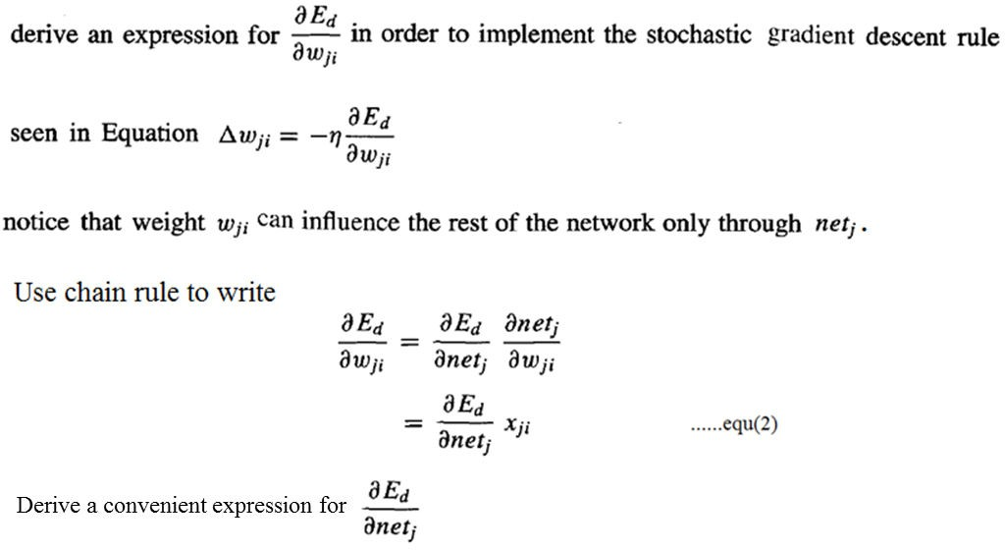
Consider two cases in turn: the case where unit j is an output unit for the network, and the case where j is an
internal unit (hidden unit).

Slide 13
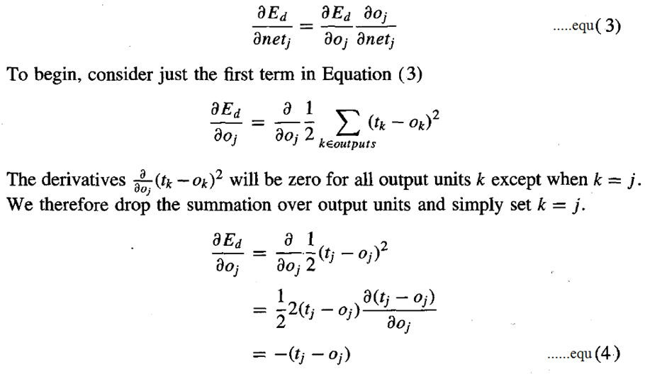
Case 1: Training Rule for Output Unit Weights.
w_{ji} can influence the rest of the network only through net_{j} , net_{j} can influence the network only through o_{j}.
Therefore, we can invoke the chain rule again to write

Slide 14
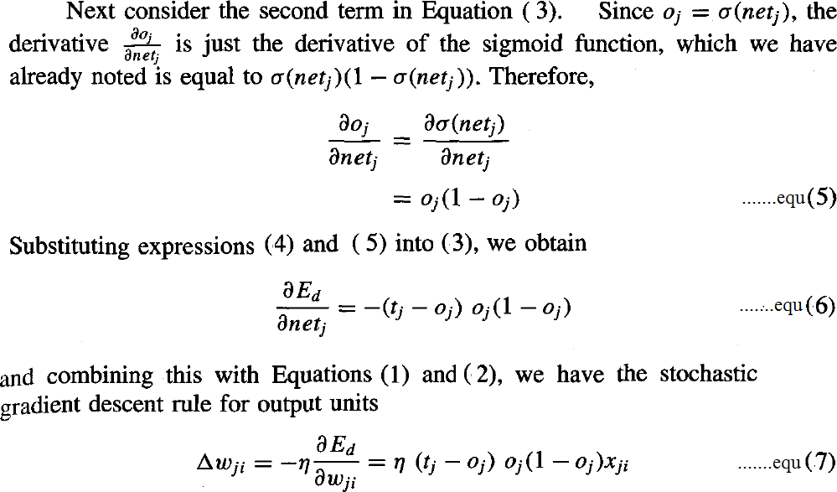

Slide 15
Case 2: Training Rule for Hidden Unit Weights.
In the case where j is an internal, or hidden unit in the network, the derivation of the training rule for w_{ji} must take into account the indirect ways in which w_{ji} can influence the network outputs and hence E_{d}.
For this reason, we will find it useful to refer to the set of all units immediately downstream of unit j in the network and denoted this set of units by Downstream( j).
net_{j} can influence the network outputs only through the units in Downstream(j).
Therefore, we can write

Slide 16
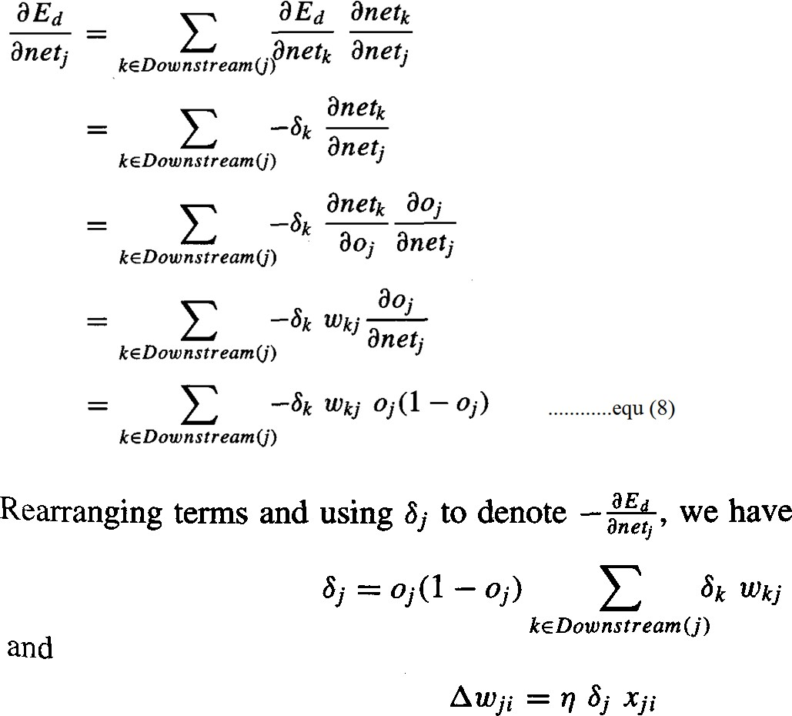

Slide 17
REMARKS ON THE BACKPROPAGATION ALGORITHM
1. Convergence and Local Minima
The BACKPROPAGATION multilayer networks is only guaranteed to converge toward some local minimum in E and not necessarily to the global minimum error.
Despite the lack of assured convergence to the global minimum error, BACKPROPAGATION is a highly effective function approximation method in practice.
Local minima can be gained by considering the manner in which network weights evolve as the number of training iterations increases.
Common heuristics to attempt to alleviate the problem of local minima include:
Add a momentum term to the weight-update rule. Momentum can sometimes carry the gradient descent procedure through narrow local minima
Use stochastic gradient descent rather than true gradient descent
Train multiple networks using the same data, but initializing each network with different random weights

Slide 18
2. Representational Power of Feedforward Networks
What set of functions can be represented by feed-forward networks?
The answer depends on the width and depth of the networks. There are three quite general results are known about which function classes can be described by which types of Networks
1. Boolean functions – Every boolean function can be represented exactly by some network with two layers of units, although the number of hidden units required grows exponentially in the worst case with the number of network inputs
2. Continuous functions – Every bounded continuous function can be
approximated with arbitrarily small error by a network with two layers of units
3. Arbitrary functions – Any function can be approximated to arbitrary accuracy by a network with three layers of units.

Slide 19
3. Hypothesis Space Search and Inductive Bias
Hypothesis space is the n-dimensional Euclidean space of the n network weights and hypothesis space is continuous.
As it is continuous, E is differentiable with respect to the continuous parameters of the hypothesis, results in a well-defined error gradient that provides a very useful structure for organizing the search for the best hypothesis.
It is difficult to characterize precisely the inductive bias of BACKPROPAGATION algorithm, because it depends on the interplay between the gradient descent search and the way in which the weight space spans the space of representable functions. However, one can roughly characterize it as smooth interpolation between data points.

Slide 20
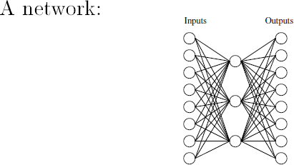
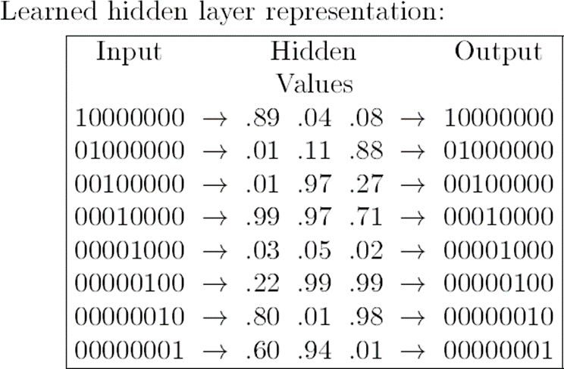
4. Hidden Layer Representations
BACKPROPAGATION can define new hidden layer features that are not explicit in the input representation, but which capture properties of the input instances that are most relevant to learning the target function.
Consider example, the network shown in below Figure

Slide 21
Consider training the network shown in Figure to learn the simple target function f
(x) = x, where x is a vector containing seven 0's and a single 1.
The network must learn to reproduce the eight inputs at the corresponding eight output units. Although this is a simple function, the network in this case is constrained to use only three hidden units. Therefore, the essential information from all eight input units must be captured by the three learned hidden units.
When BACKPROPAGATION applied to this task, using each of the eight possible vectors as training examples, it successfully learns the target function. By examining the hidden unit values generated by the learned network for each of the eight possible input vectors, it is easy to see that the learned encoding is similar to the familiar standard binary encoding of eight values using three bits (e.g., 000,001,010,. . . , 111). The exact values of the hidden units for one typical run of shown in Figure.
This ability of multilayer networks to automatically discover useful representations at the hidden layers is a key feature of ANN learning

Slide 22
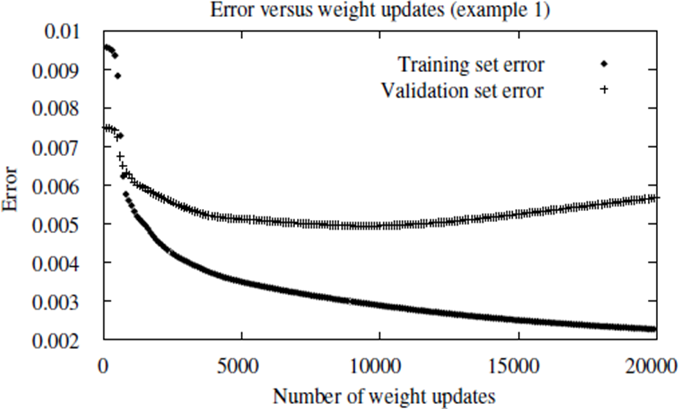
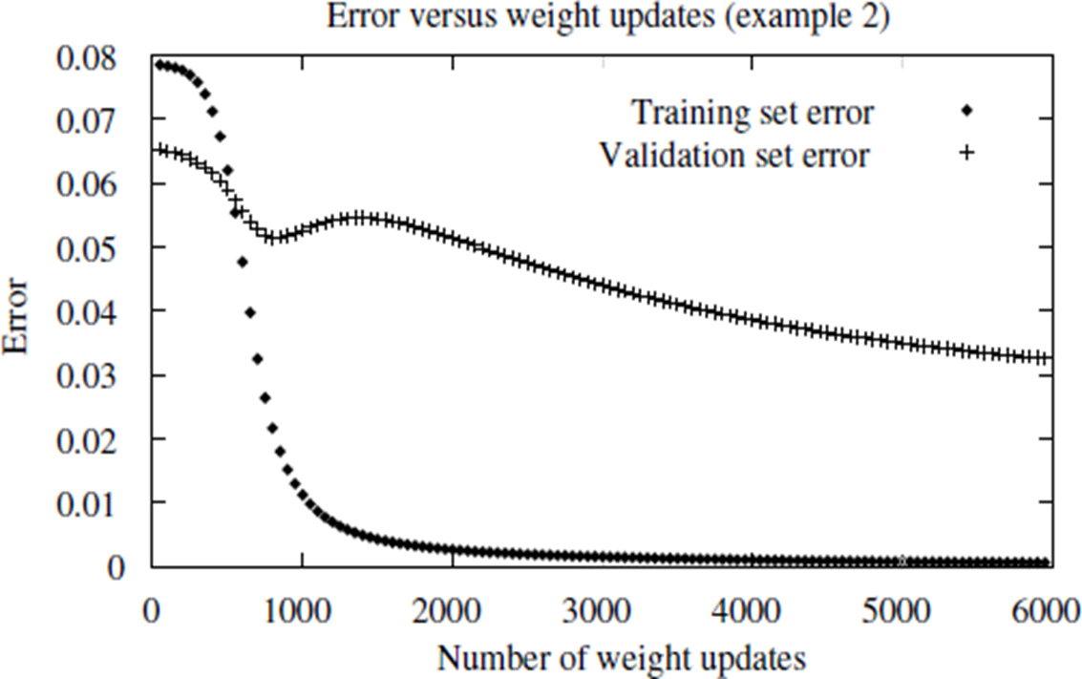
5. Generalization, Overfitting, and Stopping Criterion
What is an appropriate condition for terminating the weight update loop?
One choice is to continue training until the error E on the training examples falls below some predetermined threshold.
To see the dangers of minimizing the error over the training data, consider how the error E varies with the number of weight iterations

Slide 23
Consider first the top plot in this figure. The lower of the two lines shows the monotonically decreasing error E over the training set, as the number of gradient descent iterations grows. The upper line shows the error E measured over a different validation set of examples, distinct from the training examples. This line measures the generalization accuracy of the network-the accuracy with which it fits examples beyond the training data.
The generalization accuracy measured over the validation examples first decreases, then increases, even as the error over the training examples continues to decrease. How can this occur? This occurs because the weights are being tuned to fit idiosyncrasies of the training examples that are not representative of the general distribution of examples. The large number of weight parameters in ANNs provides many degrees of freedom for fitting such idiosyncrasies
Why does overfitting tend to occur during later iterations, but not during earlier iterations?
By giving enough weight-tuning iterations, BACKPROPAGATION will often be able to create overly complex decision surfaces that fit noise in the training data or unrepresentative characteristics of the particular training sample.

Slide 24
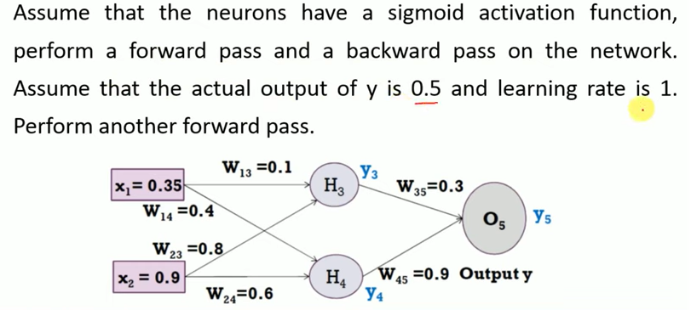
Backpropagation Example 1

Slide 25
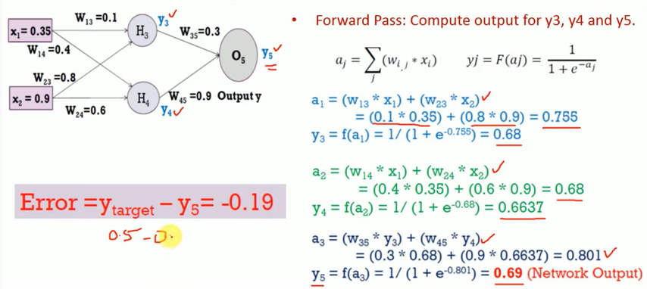

Slide 26
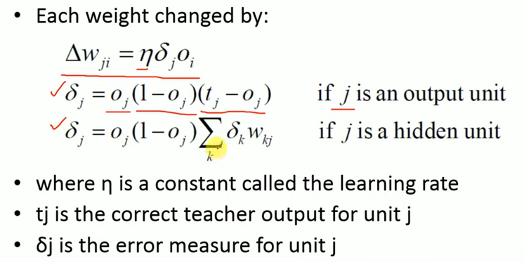

Slide 27
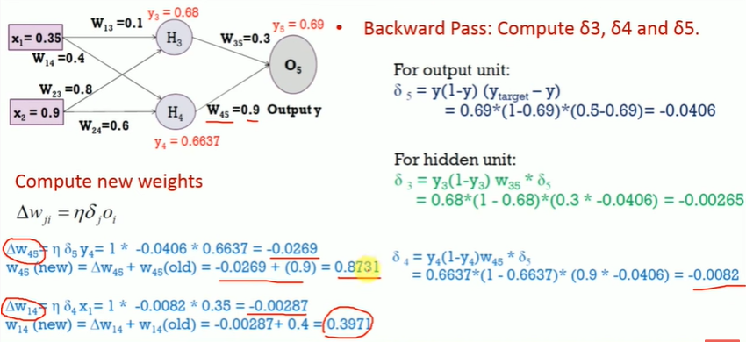

Slide 28
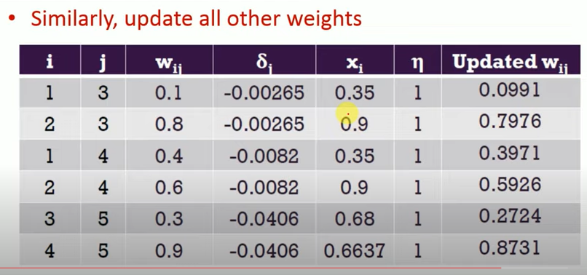

Slide 29
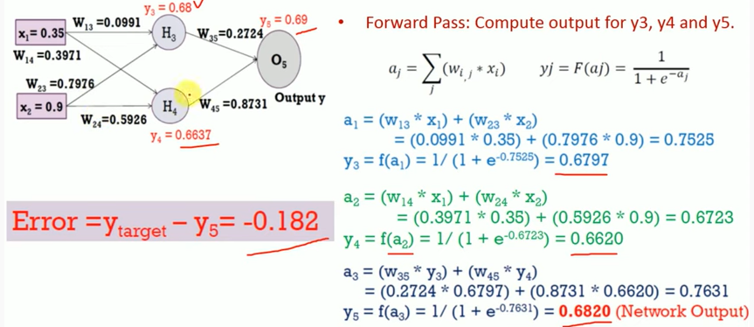

Slide 30
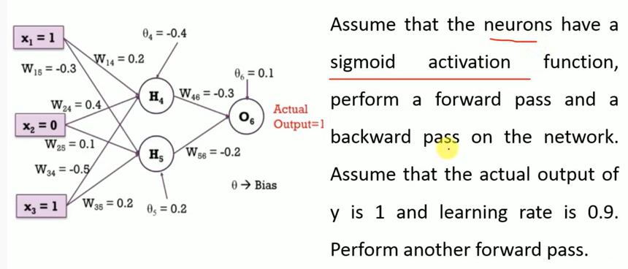
Backpropagation Example 2

Slide 31
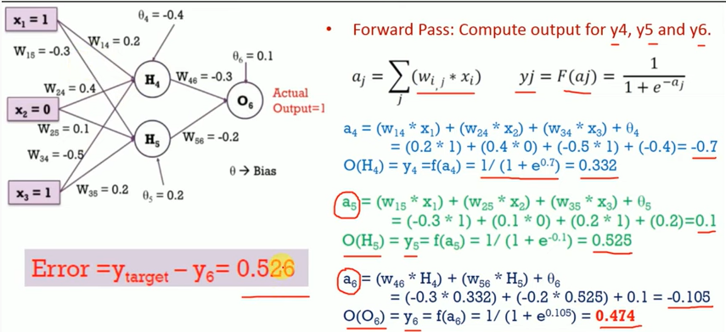

Slide 32
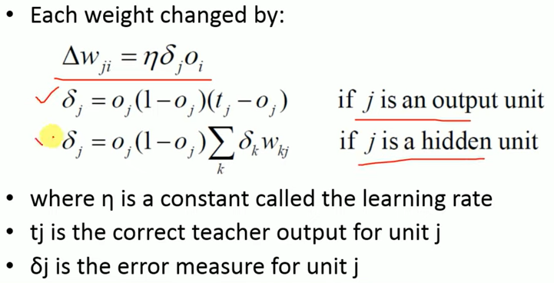

Slide 33
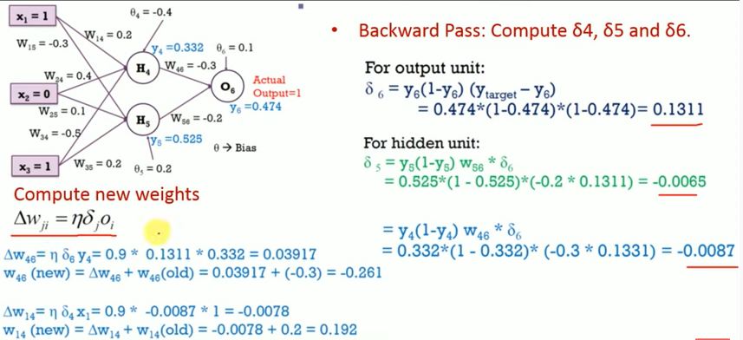

Slide 34
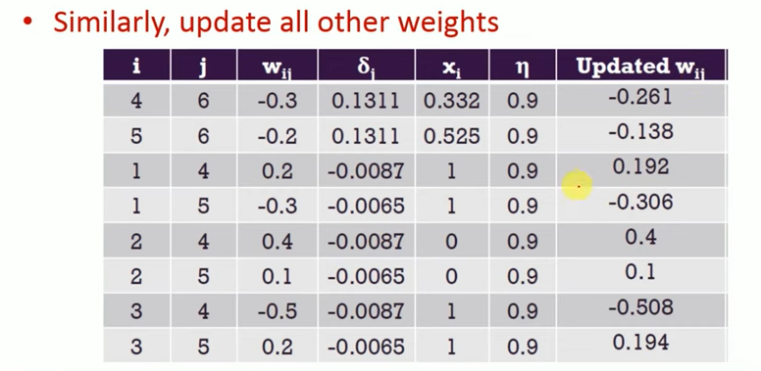
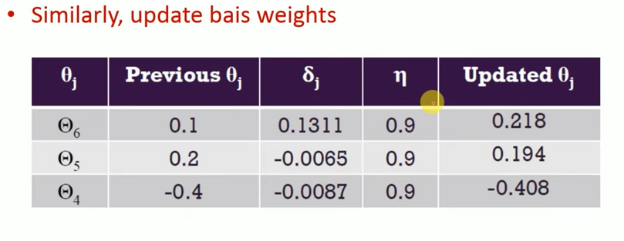

Slide 35
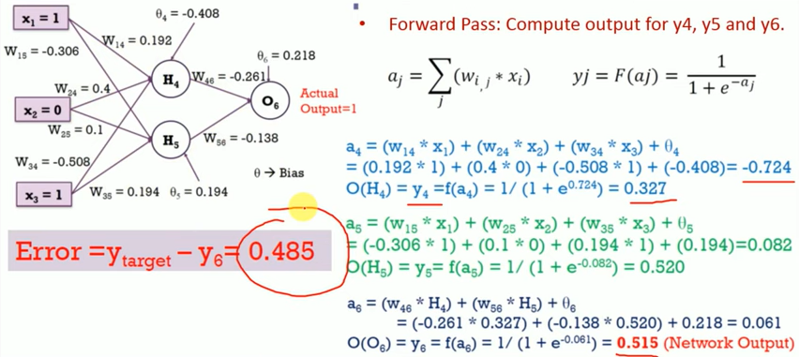

Slide 36
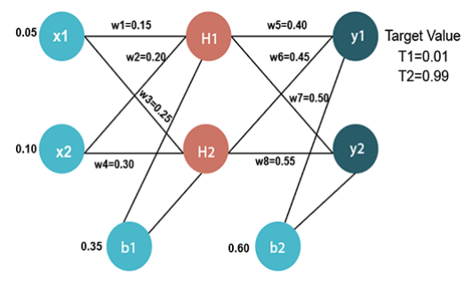
Back propagation Example:

